Slide 1

Introduction to Cyber Security
Ritesh Dhanare
Assistant Professor
Information technology Department

Slide 2
Table of Contents
Firewalls,
Kinds of Firewalls,
Filtering Services,
DMZ,
Implementing policies (Default allow, Default Deny) on proxy,
NAT,
Intrusion Detection and Prevention Systems,
types of IDPS,
Virtual Private Network,
SSH,
Security information and event management (SIEM)

Slide 3
Firewalls
What Is a Firewall?
A firewall is a device that filters all traffic between a protected or "inside" network and a less trustworthy or "outside" network.
Usually a firewall runs on a dedicated device; because it is a single point through which traffic is channeled, performance is important, which means non firewall functions should not be done on the same machine.

Slide 4
Firewalls
Design of Firewalls
always invoked
tamperproof
small and simple enough for rigorous analysis

Slide 5
Types of Firewalls
Firewalls have a wide range of capabilities. Types of firewalls include
packet filtering gateways or screening routers
Stateful inspection firewalls
application proxies
guards
personal firewalls

Slide 6
Packet Filtering Gateway
A packet filtering gateway or screening router is the simplest, and in some situations, the most effective type of firewall.
A packet filtering gateway controls access to packets on the basis of packet address (source or destination) or specific transport protocol type (such as HTTP web traffic).

Slide 7
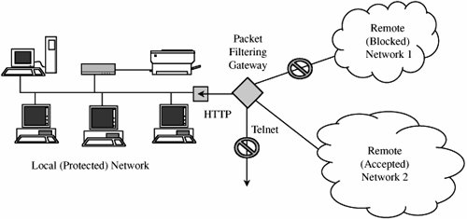
Packet Filtering Gateway

Slide 8
Stateful inspection firewalls
Filtering firewalls work on packets one at a time, accepting or rejecting each packet and moving on to the next.
They have no concept of "state" or "context" from one packet to the next.
A stateful inspection firewall maintains state information from one packet to another in the input stream.

Slide 9
Application Proxy
An application proxy gateway, also called a bastion host, is a firewall that simulates the (proper) effects of an application so that the application receives only requests to act properly.
A proxy gateway is a two-headed device: It looks to the inside as if it is the outside (destination) connection, while to the outside it responds just as the insider would
Notes:
To understand the real purpose of a proxy gateway, let us consider several examples.
􀁺 A company wants to set up an online price list so that outsiders can see the products and prices offered. It wants to be sure that (a)
no outsider can change the prices or product list and (b) outsiders can access only the price list, not any of the more sensitive files
stored inside.
􀁺 A school wants to allow its students to retrieve any information from World Wide Web resources on the Internet. To help provide
efficient service, the school wants to know what sites have been visited and what files from those sites have been fetched;
particularly popular files will be cached locally.
􀁺 A government agency wants to respond to queries through a database management system. However, because of inference attacks
against databases, the agency wants to restrict queries that return the mean of a set of fewer than five values.
􀁺 A company with multiple offices wants to encrypt the data portion of all e-mail to addresses at its other offices. (A corresponding
proxy at the remote end will remove the encryption.)
􀁺 A company wants to allow dial-in access by its employees, without exposing its company resources to login attacks from remote
nonemployees.

Slide 10
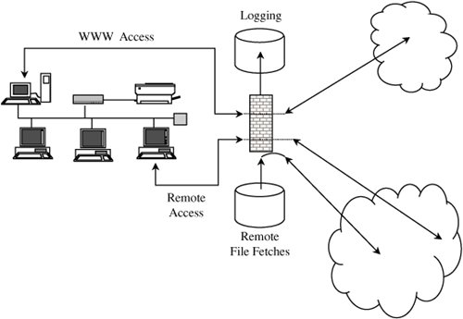
Application Proxy
Notes:
To understand the real purpose of a proxy gateway, let us consider several examples.
􀁺 A company wants to set up an online price list so that outsiders can see the products and prices offered. It wants to be sure that (a)
no outsider can change the prices or product list and (b) outsiders can access only the price list, not any of the more sensitive files
stored inside.
􀁺 A school wants to allow its students to retrieve any information from World Wide Web resources on the Internet. To help provide
efficient service, the school wants to know what sites have been visited and what files from those sites have been fetched;
particularly popular files will be cached locally.
􀁺 A government agency wants to respond to queries through a database management system. However, because of inference attacks
against databases, the agency wants to restrict queries that return the mean of a set of fewer than five values.
􀁺 A company with multiple offices wants to encrypt the data portion of all e-mail to addresses at its other offices. (A corresponding
proxy at the remote end will remove the encryption.)
􀁺 A company wants to allow dial-in access by its employees, without exposing its company resources to login attacks from remote
nonemployees.

Slide 11
Guard
A guard is a sophisticated firewall. Like a proxy firewall, it receives protocol data units, interprets them, and passes through the same or different protocol data units that achieve either the same result or a modified result.
The guard decides what services to perform on the user's behalf in accordance with its available knowledge, such as whatever it can reliably know of the (outside) user's identity, previous interactions, and so forth.
The degree of control a guard can provide is limited only by what is computable. But guards and proxy firewalls are similar enough that the distinction between them is sometimes fuzzy. That is, we can add functionality to a proxy firewall until it starts to look a lot like a guard.
Notes:
Guard activities can be quite sophisticated, as illustrated in the following examples:
􀁺 A university wants to allow its students to use e-mail up to a limit of so many messages or so many characters of e-mail in the last
so many days. Although this result could be achieved by modifying e-mail handlers, it is more easily done by monitoring the
common point through which all e-mail flows, the mail transfer protocol.
􀁺 A school wants its students to be able to access the World Wide Web but, because of the slow speed of its connection to the web, it
will allow only so many characters per downloaded image (that is, allowing text mode and simple graphics, but disallowing
complex graphics, animation, music, or the like).
􀁺 A library wants to make available certain documents but, to support fair use of copyrighted matter, it will allow a user to retrieve
only the first so many characters of a document. After that amount, the library will require the user to pay a fee that will be
forwarded to the author.
􀁺 A company wants to allow its employees to fetch files via ftp. However, to prevent introduction of viruses, it will first pass all
incoming files through a virus scanner. Even though many of these files will be nonexecutable text or graphics, the company
administrator thinks that the expense of scanning them (which should pass) will be negligible.

Slide 12
Personal Firewalls
A personal firewall is an application program that runs on a workstation to block unwanted traffic, usually from the network.
A personal firewall can complement the work of a conventional firewall by screening the kind of data a single host will accept, or it can compensate for the lack of a regular firewall, as in a private DSL or cable modem connection.
Notes:
Guard activities can be quite sophisticated, as illustrated in the following examples:
􀁺 A university wants to allow its students to use e-mail up to a limit of so many messages or so many characters of e-mail in the last
so many days. Although this result could be achieved by modifying e-mail handlers, it is more easily done by monitoring the
common point through which all e-mail flows, the mail transfer protocol.
􀁺 A school wants its students to be able to access the World Wide Web but, because of the slow speed of its connection to the web, it
will allow only so many characters per downloaded image (that is, allowing text mode and simple graphics, but disallowing
complex graphics, animation, music, or the like).
􀁺 A library wants to make available certain documents but, to support fair use of copyrighted matter, it will allow a user to retrieve
only the first so many characters of a document. After that amount, the library will require the user to pay a fee that will be
forwarded to the author.
􀁺 A company wants to allow its employees to fetch files via ftp. However, to prevent introduction of viruses, it will first pass all
incoming files through a virus scanner. Even though many of these files will be nonexecutable text or graphics, the company
administrator thinks that the expense of scanning them (which should pass) will be negligible.

Slide 13
Personal Firewalls
Just as a network firewall screens incoming and outgoing traffic for that network, a personal firewall screens traffic on a single workstation.
A workstation could be vulnerable to malicious code or malicious active agents (ActiveX controls or Java applets), leakage of personal data stored on the workstation, and vulnerability scans to identify potential weaknesses.
Commercial implementations of personal firewalls include Norton Personal Firewall from Symantec, McAfee Personal Firewall, and Zone Alarm from Zone Labs (now owned by CheckPoint).
Notes:
Guard activities can be quite sophisticated, as illustrated in the following examples:
􀁺 A university wants to allow its students to use e-mail up to a limit of so many messages or so many characters of e-mail in the last
so many days. Although this result could be achieved by modifying e-mail handlers, it is more easily done by monitoring the
common point through which all e-mail flows, the mail transfer protocol.
􀁺 A school wants its students to be able to access the World Wide Web but, because of the slow speed of its connection to the web, it
will allow only so many characters per downloaded image (that is, allowing text mode and simple graphics, but disallowing
complex graphics, animation, music, or the like).
􀁺 A library wants to make available certain documents but, to support fair use of copyrighted matter, it will allow a user to retrieve
only the first so many characters of a document. After that amount, the library will require the user to pay a fee that will be
forwarded to the author.
􀁺 A company wants to allow its employees to fetch files via ftp. However, to prevent introduction of viruses, it will first pass all
incoming files through a virus scanner. Even though many of these files will be nonexecutable text or graphics, the company
administrator thinks that the expense of scanning them (which should pass) will be negligible.

Slide 14
Personal Firewalls
The personal firewall is configured to enforce some policy. For example, the user may decide that certain sites, such as computers on the company network, are highly trustworthy, but most other sites are not.
The user defines a policy permitting download of code, unrestricted data sharing, and management access from the corporate segment, but not from other sites.
Personal firewalls can also generate logs of accesses, which can be useful to examine in case something harmful does slip through the firewall.
Notes:
Guard activities can be quite sophisticated, as illustrated in the following examples:
􀁺 A university wants to allow its students to use e-mail up to a limit of so many messages or so many characters of e-mail in the last
so many days. Although this result could be achieved by modifying e-mail handlers, it is more easily done by monitoring the
common point through which all e-mail flows, the mail transfer protocol.
􀁺 A school wants its students to be able to access the World Wide Web but, because of the slow speed of its connection to the web, it
will allow only so many characters per downloaded image (that is, allowing text mode and simple graphics, but disallowing
complex graphics, animation, music, or the like).
􀁺 A library wants to make available certain documents but, to support fair use of copyrighted matter, it will allow a user to retrieve
only the first so many characters of a document. After that amount, the library will require the user to pay a fee that will be
forwarded to the author.
􀁺 A company wants to allow its employees to fetch files via ftp. However, to prevent introduction of viruses, it will first pass all
incoming files through a virus scanner. Even though many of these files will be nonexecutable text or graphics, the company
administrator thinks that the expense of scanning them (which should pass) will be negligible.

Slide 15
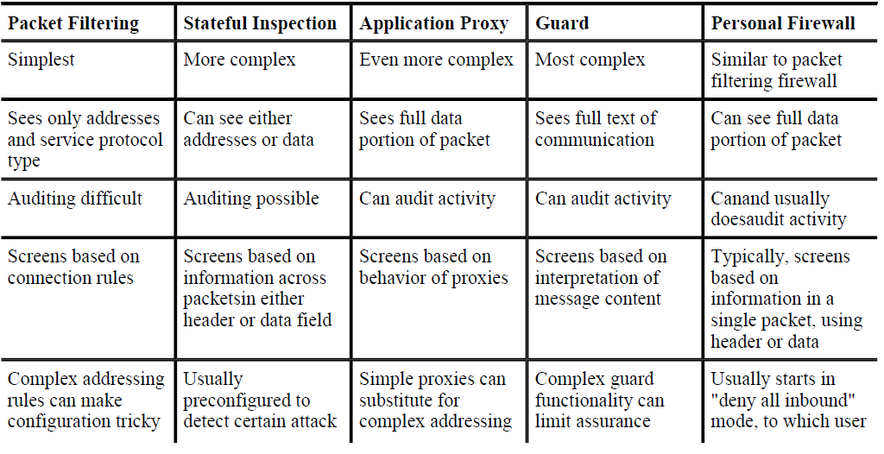

Slide 16
What Firewalls Can and Cannot Block
Firewalls can protect an environment only if the firewalls control the entire perimeter. That is, firewalls are effective only if no unmediated connections breach the perimeter. If even one inside host connects to an outside address, by a modem for example, the entire inside net is vulnerable through the modem and its host.

Slide 17
What Firewalls Can and Cannot Block
Firewalls do not protect data outside the perimeter; data that have properly passed (outbound) through the firewall are just as exposed as if there were no firewall.
Firewalls are the most visible part of an installation to the outside, so they are the most attractive target for attack. For this reason, several different layers of protection, called defense in depth, are better than relying on the strength of just a single firewall.

Slide 18
What Firewalls Can and Cannot Block
Firewalls must be correctly configured, that configuration must be updated as the internal and external environment changes, and firewall activity reports must be reviewed periodically for evidence of attempted or successful intrusion.
Firewalls are targets for penetrators. While a firewall is designed to withstand attack, it is not impenetrable. Designers intentionally keep a firewall small and simple so that even if a penetrator breaks it, the firewall does not have further tools, such as compilers, linkers, loaders, and the like, to continue an attack.

Slide 19
Firewalls exercise only minor control over the content admitted to the inside, meaning that inaccurate data or malicious code must be controlled by other means inside the perimeter.

Slide 20
Intrusion Detection Systems
An intrusion detection system (IDS) is a device, typically another separate computer, that monitors activity to identify malicious or suspicious events.

Slide 21
Intrusion Detection Systems
IDSs perform a variety of functions:
monitoring users and system activity
auditing system configuration for vulnerabilities and misconfigurations
assessing the integrity of critical system and data files
recognizing known attack patterns in system activity
identifying abnormal activity through statistical analysis
managing audit trails and highlighting user violation of policy or normal activity
correcting system configuration errors
installing and operating traps to record information about intruders

Slide 22
Types of IDSs
The two general types of intrusion detection systems are signature based and heuristic.
Signature-based intrusion detection systems perform simple pattern-matching and report situations that match a pattern corresponding to a known attack type.
Heuristic intrusion detection systems, also known as anomaly based, build a model of acceptable behavior and flag exceptions to that model

Slide 23
Types of IDSs
Intrusion detection devices can be network based or host based.
A network-based IDS is a stand-alone device attached to the network to monitor traffic throughout that network;
a host-based IDS runs on a single workstation or client or host, to protect that one host.

Slide 24
Goals for Intrusion Detection Systems
Filter on packet headers
Filter on packet content
Maintain connection state
Use complex, multipacket signatures
Use minimal number of signatures with maximum effect
Filter in real time, online
Hide its presence
Use optimal sliding time window size to match signatures

Slide 25
Responding to Alarms
Monitor, collect data, perhaps increase amount of data collected
Protect, act to reduce exposure
Call a human

Slide 26
False Results
False positive
True negative

